Slide 1
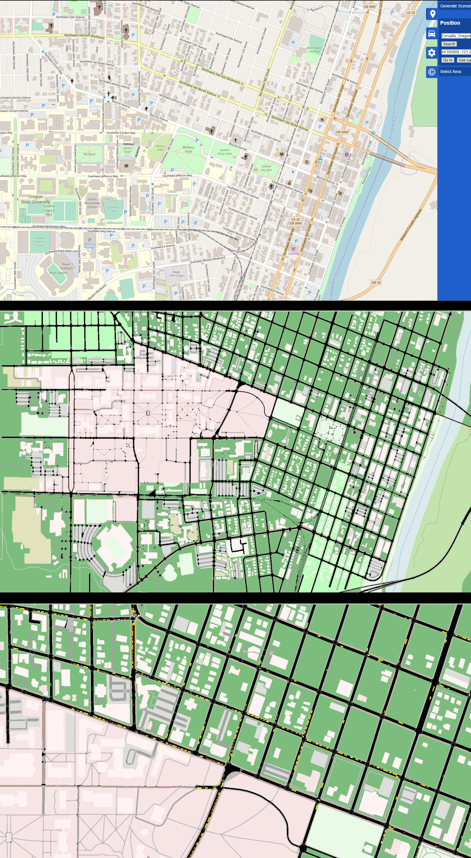
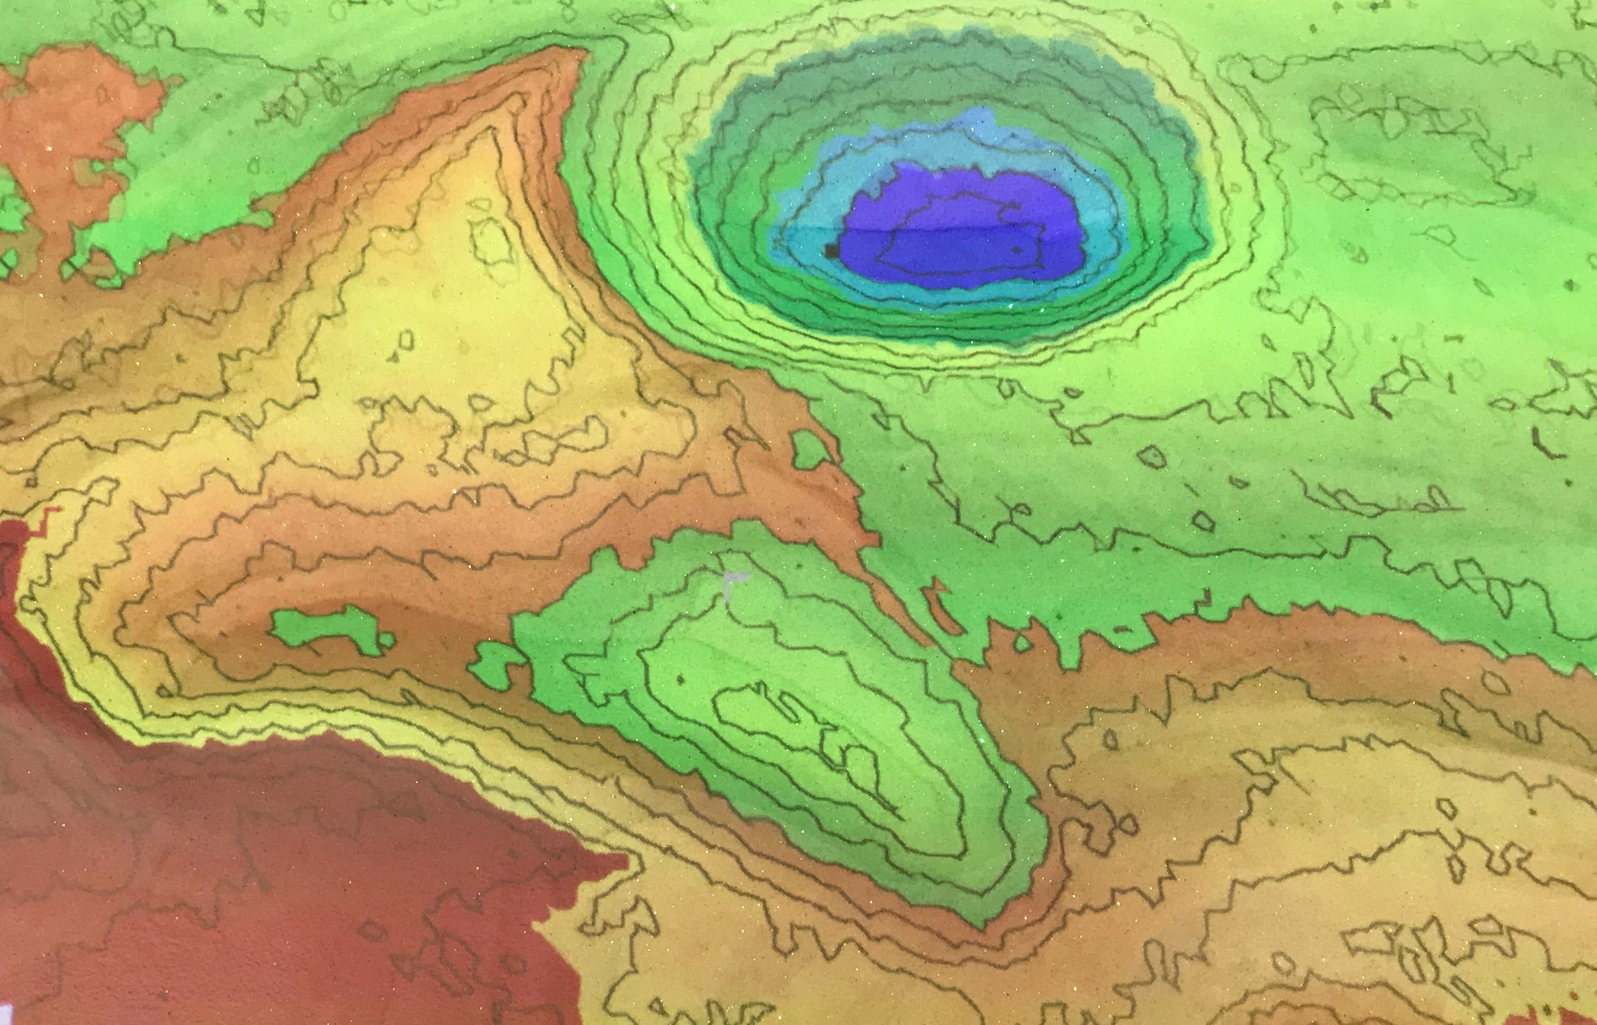
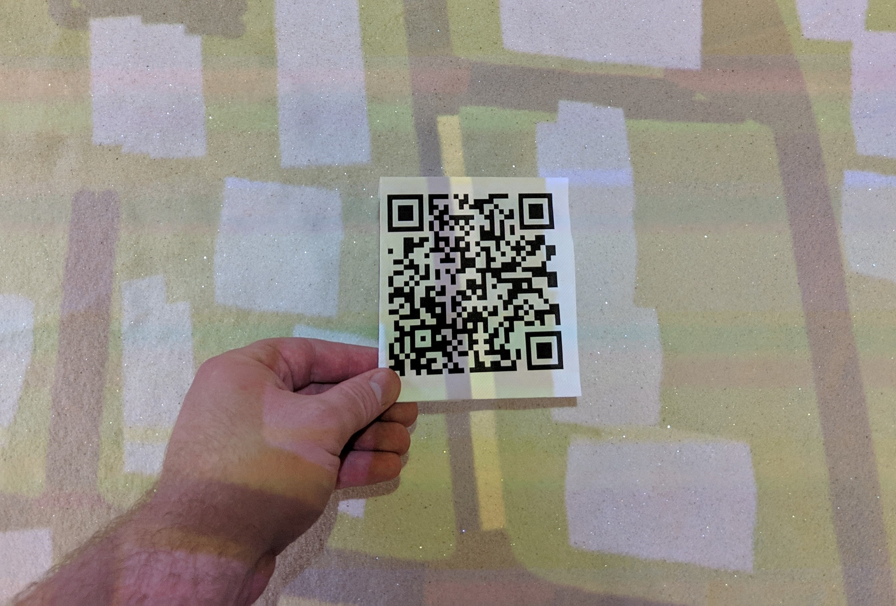
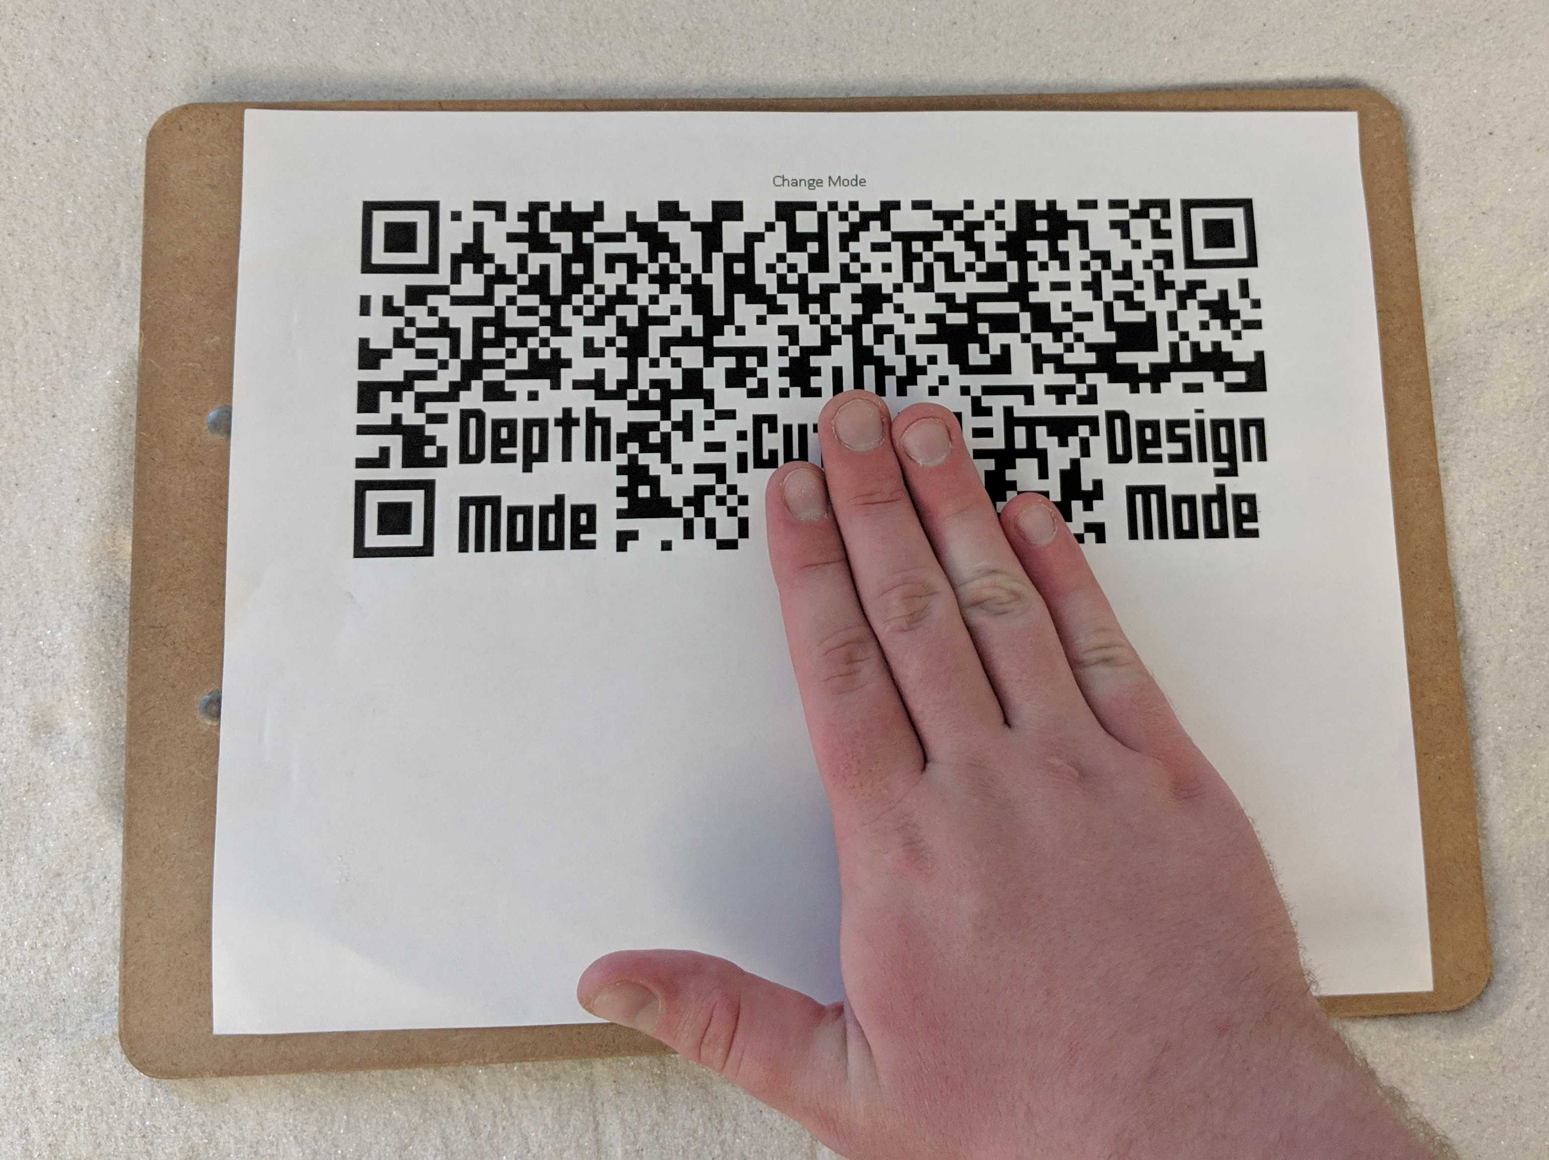
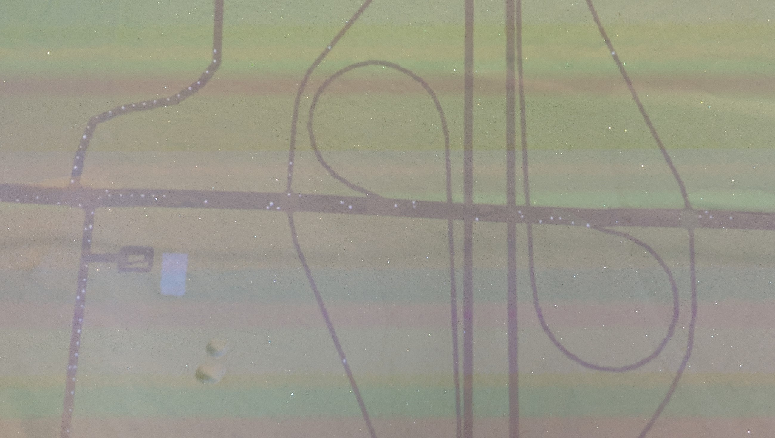
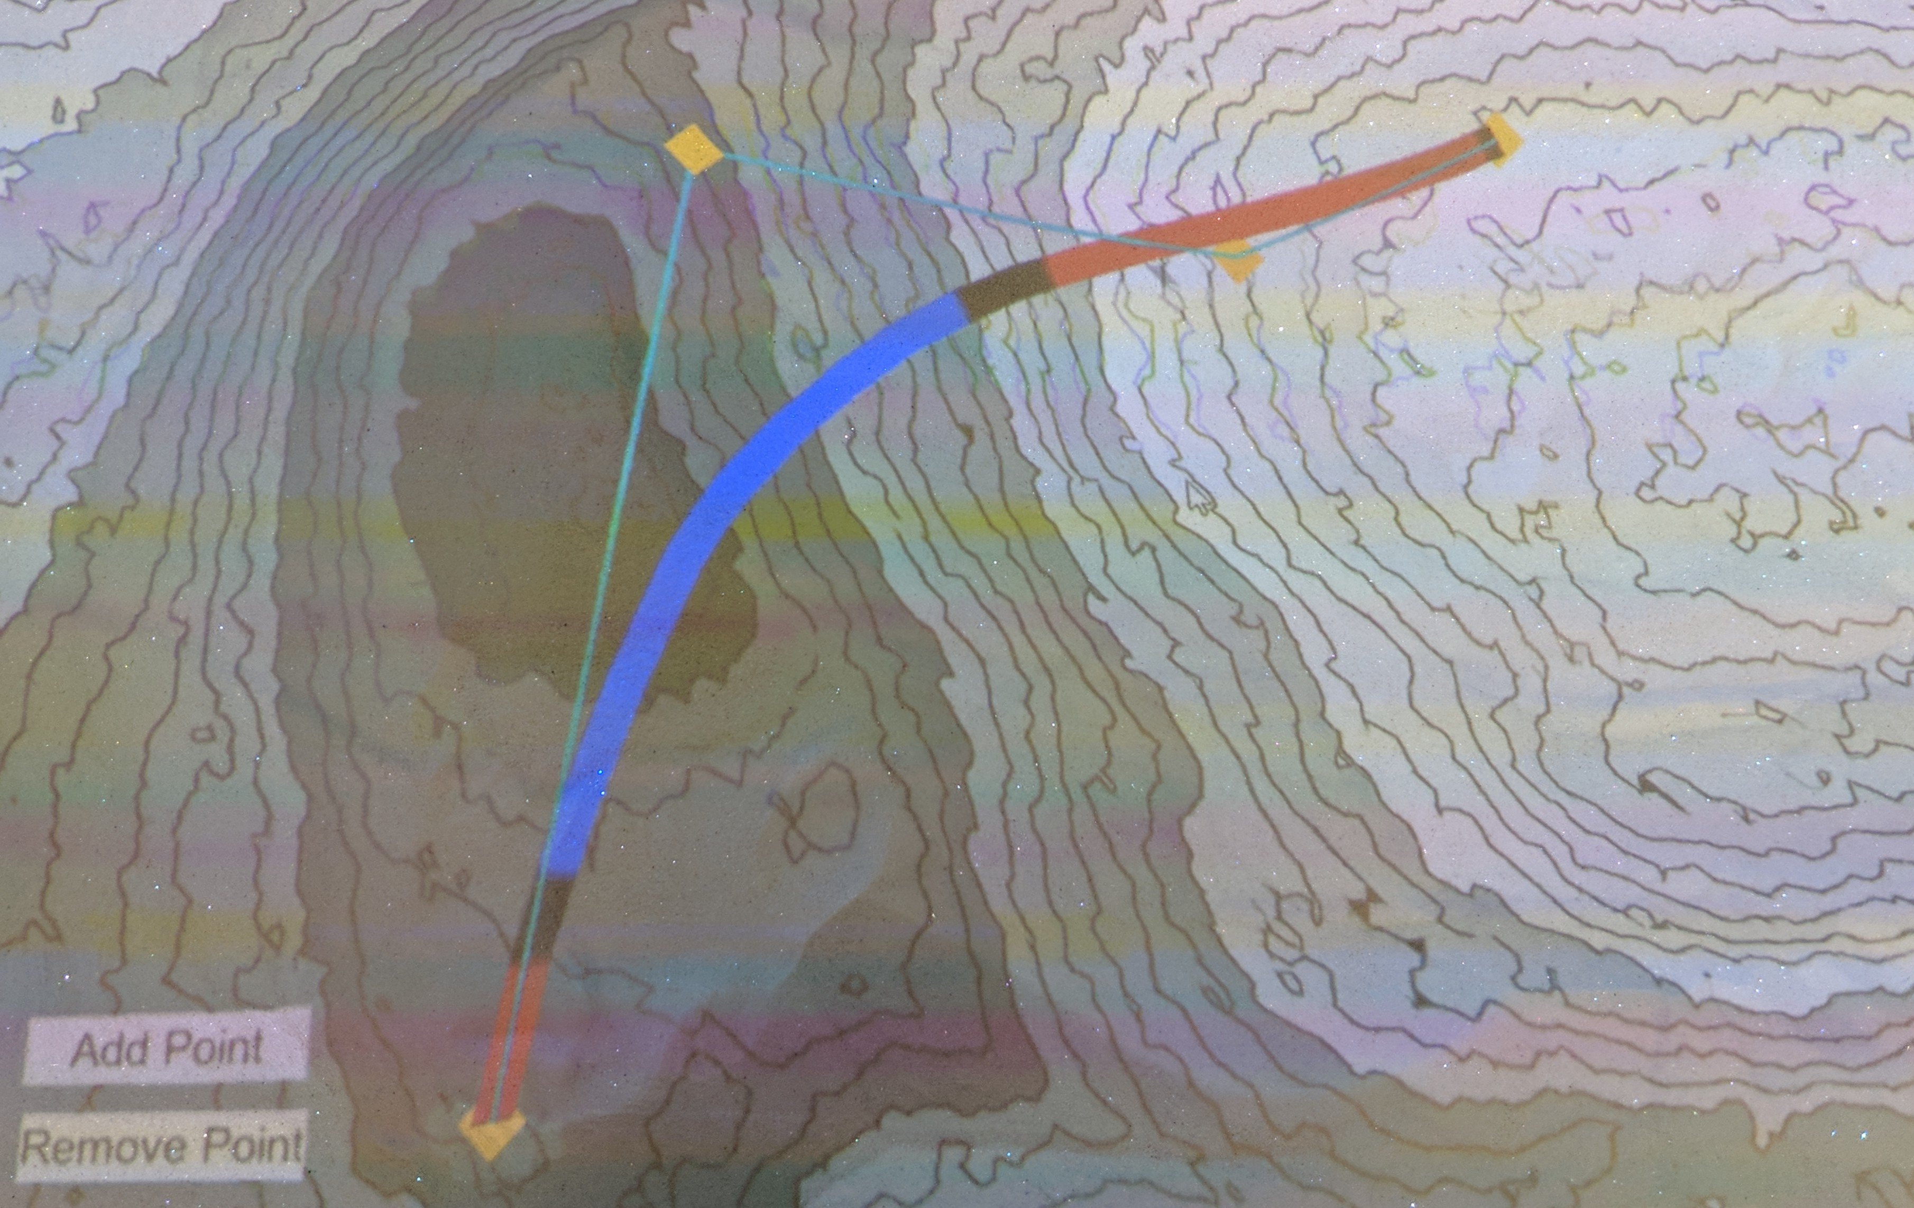
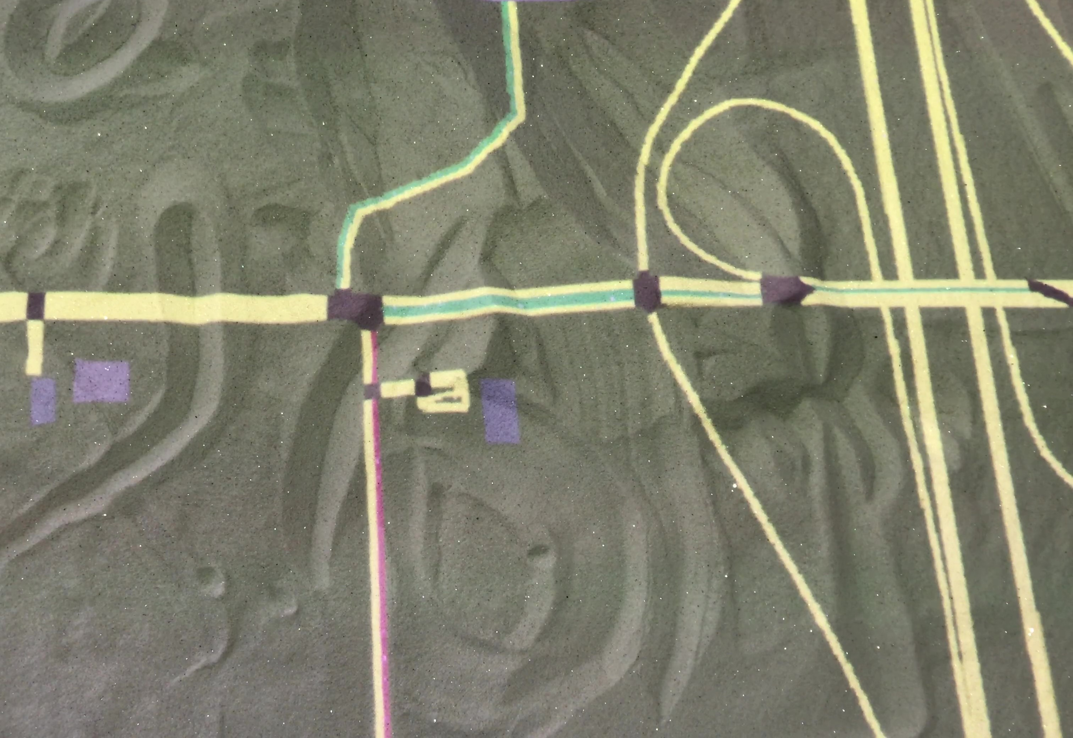
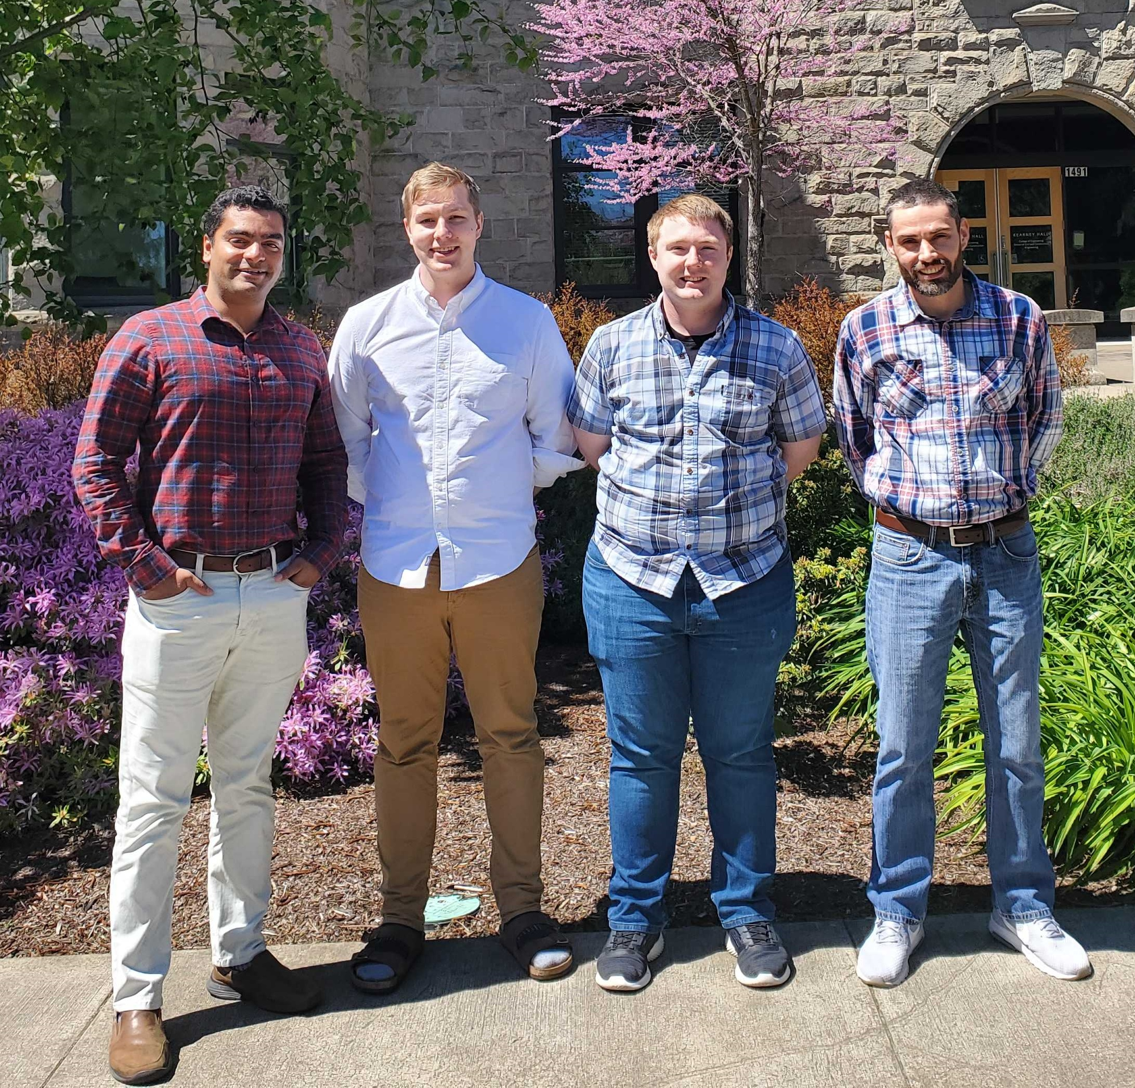
CS56
TRAFFIC SIMULATION
SUMO: SIMULATION OF URBAN MOBILITY
AR sandbox Interactive
Traffic simulation
USER INTERACTION
VUFORIA® AUGMENTED REALITY
Sumo specializes in efficient, large-network simulations.
Multiple simulations types are supported, and live changes can be made during run-time.
Importing of OpenStreetMap© road networks is supported, and, with minor modifications, can help automatically process a network for a specific scenario.
Many open-sourced tools are provided to help modify, visualize, and summarize simulations.
Vuforia Engine uses computer vision and deep learning to detect and track images.
Physical markers are used to interact with virtual traffic simulations.
An interactable medium like augmented reality improves student engagement.
Making education more engaging with augmented reality
Figure 4: Improved depth mode with contour lines
Figure 6: A marker being used to create a work zone on a road
Figure 7: A set of virtual buttons used for menu interaction
Figure 1: A traffic simulation in microscopic view
Figure 3: Importing a map of Corvallis from OpenStreetMaps
Figure 5: Improved design mode with contour lines
Figure 2: A traffic simulation in mesoscopic view
Improvements on previous work
Added Functionality
In addition to the traffic simulation mode, enhancements have been made including:
Improvements to the topographical view color scheme and added contour lines.
Inclusion of "virtual buttons" for menu functions.
Saving and loading of sandbox topographies.
Road network import and creation in Unity® 3D and SUMO.
Procedurally generated 3D scenes.
Real-time interactive traffic simulations.
Augmented reality marker integration.
From left to right: Dr. Joseph Louis, Jonah Spencer, McKenzie Gray, Adam Sunderman

